Slide 1

Demystify Employee Leaving
Predictive Model using ML
Presented By
Arshad Bagde Anitya Umare
Nimish Ukey Sangeeta Kamite

Slide 2
Introduction
Workers are quitting their jobs at record rates, thanks to a tight labor market and high confidence that moving on will also mean moving up, particularly in pay.
Besides leaving in search of more money, recent job-quitters have also cited toxic work environments and limited room for growth as major reasons for putting in their notice.
For employers, this kind of insight might only become clear during an employee’s exit interview, if at all. But with the help of artificial intelligence and machine learning, we have developed an algorithm that may be a better predictor of when a worker is at risk of quitting.

Slide 3
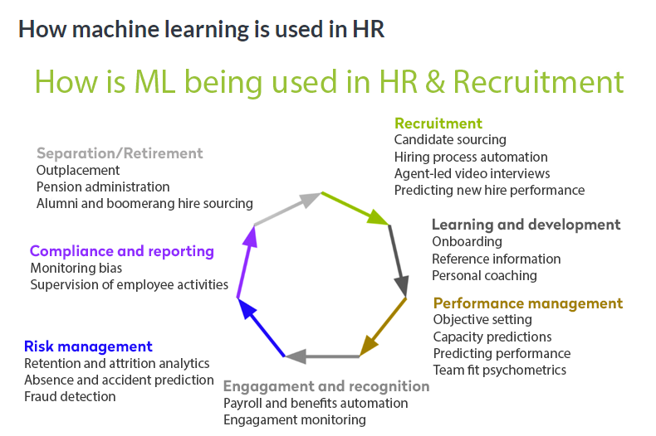

Slide 4

Work of Action
Data Engineering/Preparations
(Load, clean, and format)
Data Processing
(Data Split, Scaling, and balancing)
Model Creation and Evaluation
Conclusions

Slide 5
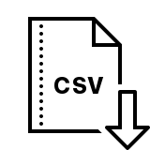
Database
IBM HR Analytics Employee Attrition
https://www.kaggle.com/pavansubhasht/ibm-hr-analytics-attrition-dataset/activity

Slide 6
Data Variables Overview
Age
Attrition
BusinessTravel
DailyRate
Department
DistanceFromHome
Education
EducationField
EmployeeCount
EmployeeNumber
EnvironmentSatisfaction
Gender
HourlyRate
JobInvolvement
JobLevel
JobRole
JobSatisfaction
MaritalStatus
MonthlyIncome
MonthlyRate
NumCompaniesWorked
Over18
OverTime
PercentSalaryHike
PerformanceRating
RelationshipSatisfaction
StandardHours
JobRole
JobSatisfaction
MaritalStatus
MonthlyIncome
MonthlyRate
NumCompaniesWorked
Over18 OverTime
PercentSalaryHike
PerformanceRating
RelationshipSatisfaction
StandardHours
StockOptionLevel
TotalWorkingYears
TrainingTimesLastYear
WorkLifeBalance
YearsAtCompany
YearsInCurrentRole
YearsSinceLastPromotion
YearsWithCurrManager

Slide 7
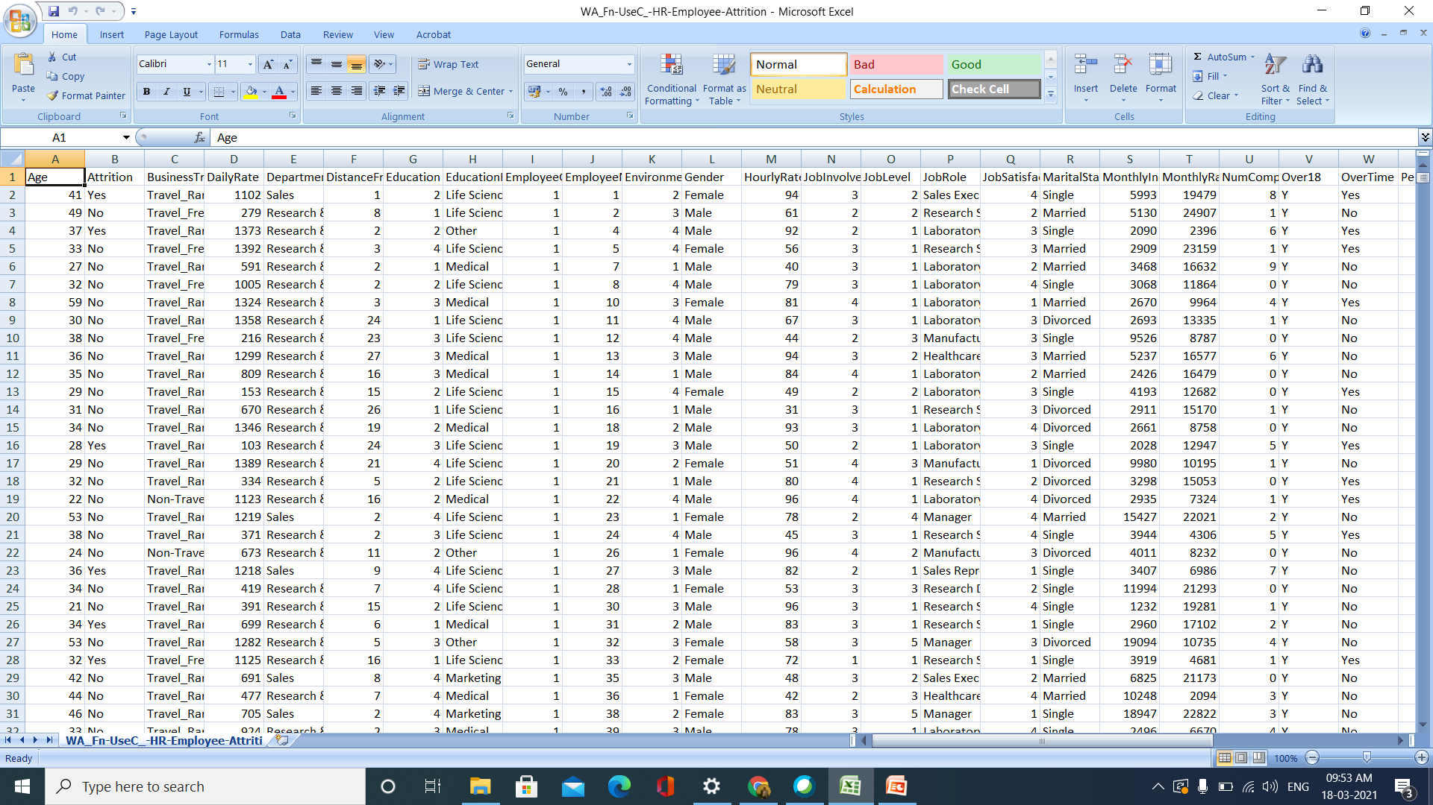

Slide 8
Data Cleaning
Delete the unused columns

Slide 9
Used Functions
Segregating the categorical variables from numerical ones.
We used the datatype method to find categorical variables, as their dtype would be ‘object’.
Encoded categorical variables to numericals.
OneHotEncoder from sklearn
get_dummies() from pandas
SMOTE method was implemented to oversample the minority classes
Concatenated the encoded categorical and numerical variables together to generate the target variable.

Slide 10
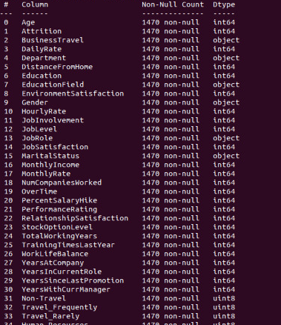
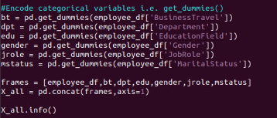

Slide 11
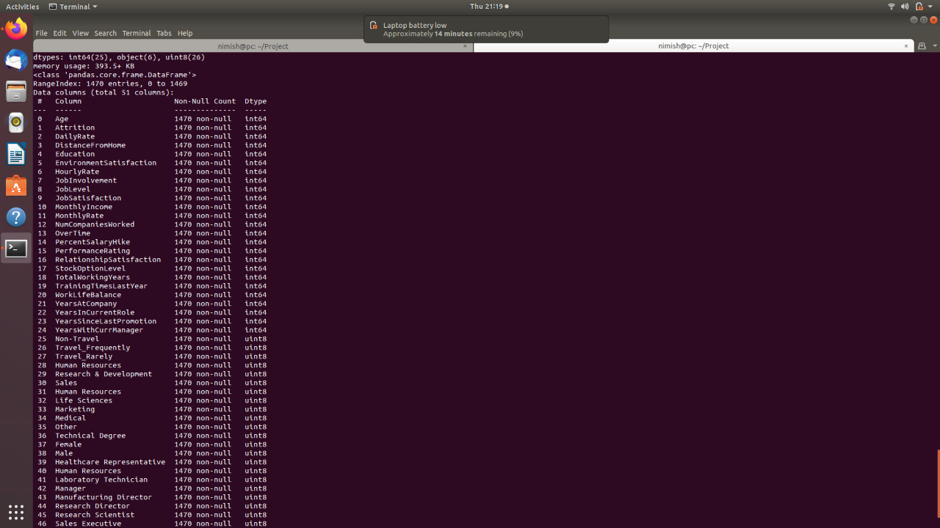

Slide 12
Models Used
Logistic Regression
Random Forest
Artificial Neural Network

Slide 13
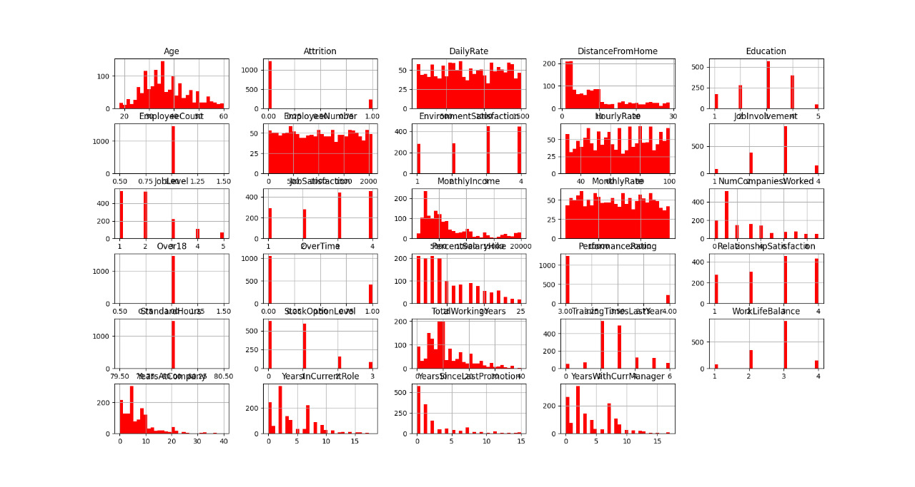
Analysis Charts
Fig 1. Distribution analysis for numerical variables

Slide 14
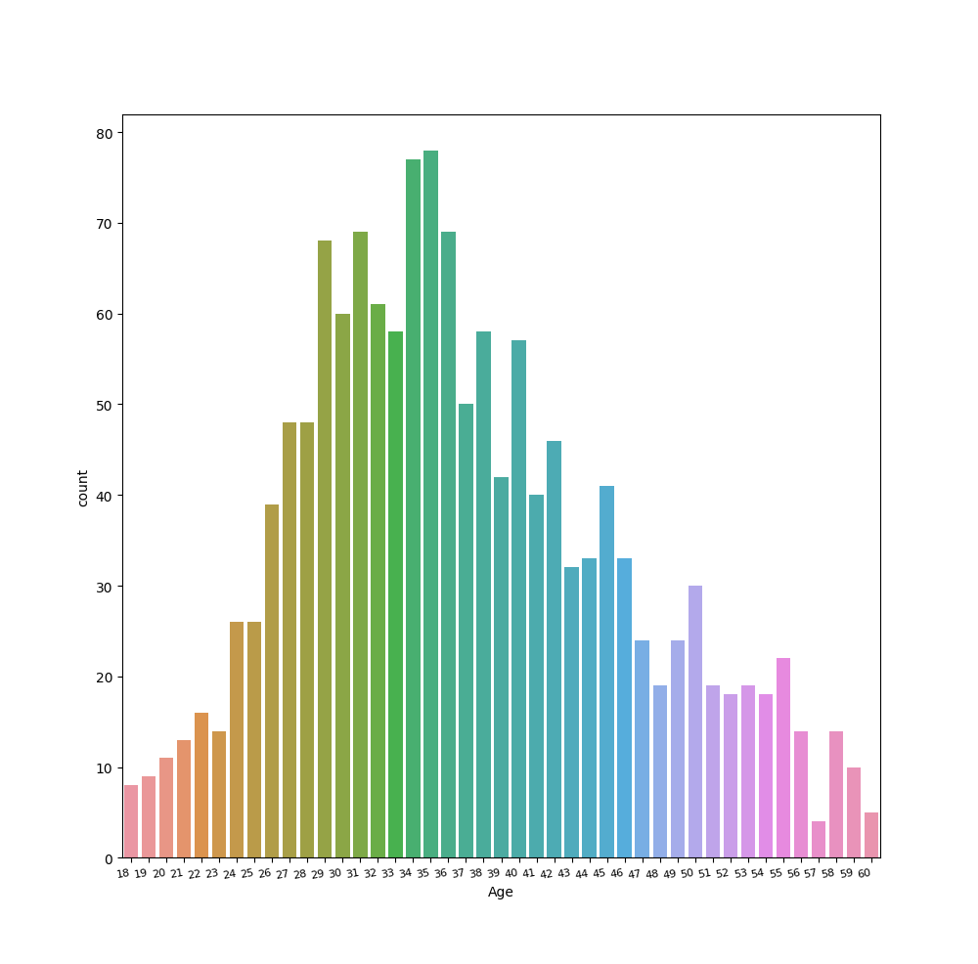
Analysis Charts
Fig 2. Distribution analysis of employee Age

Slide 15
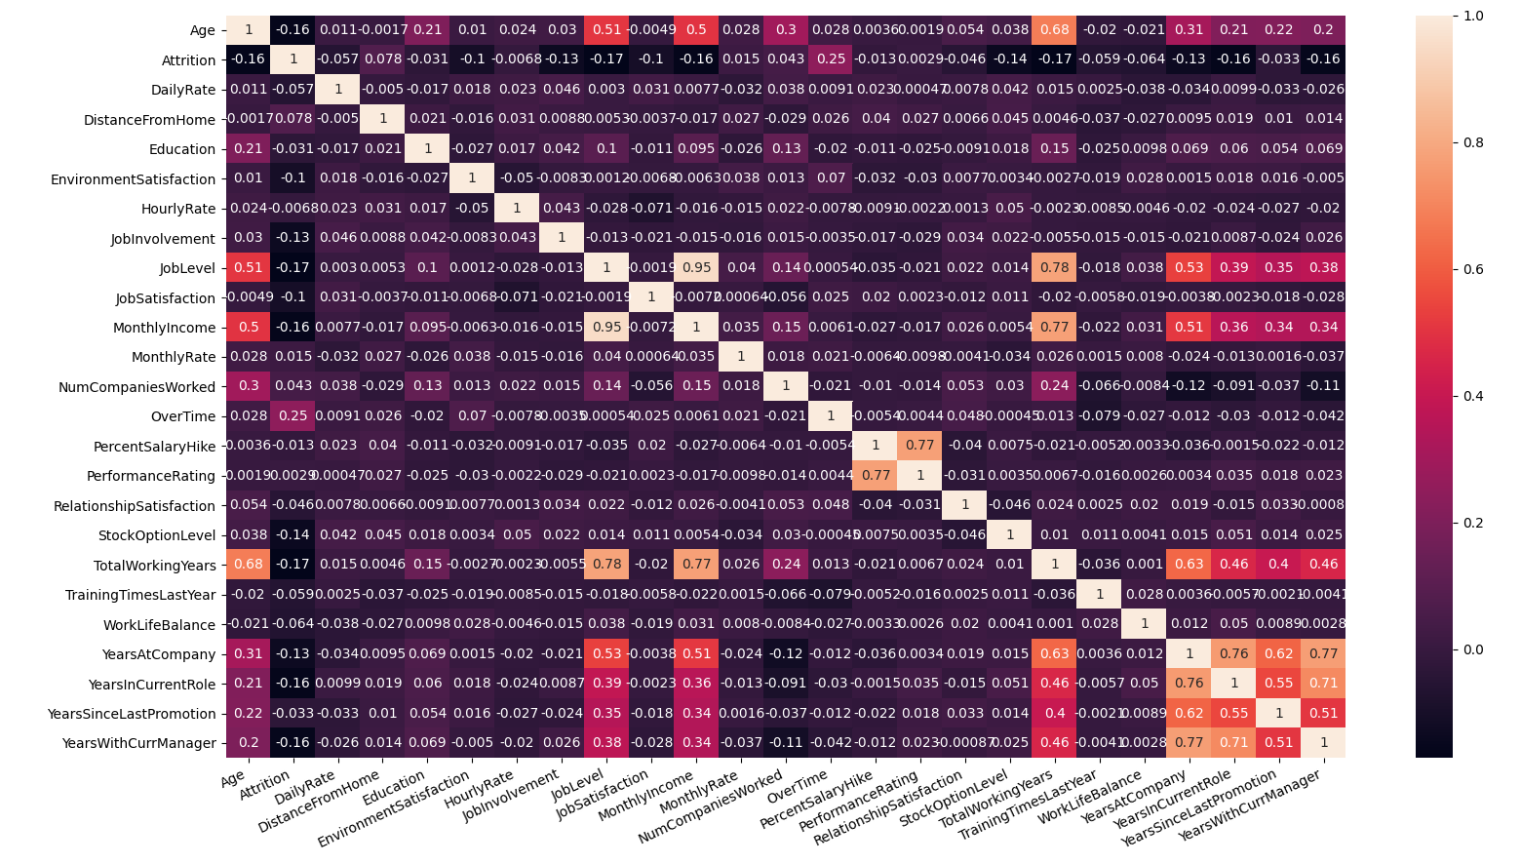
Analysis Charts
Fig 3. Correlation analysis for predictors

Slide 16
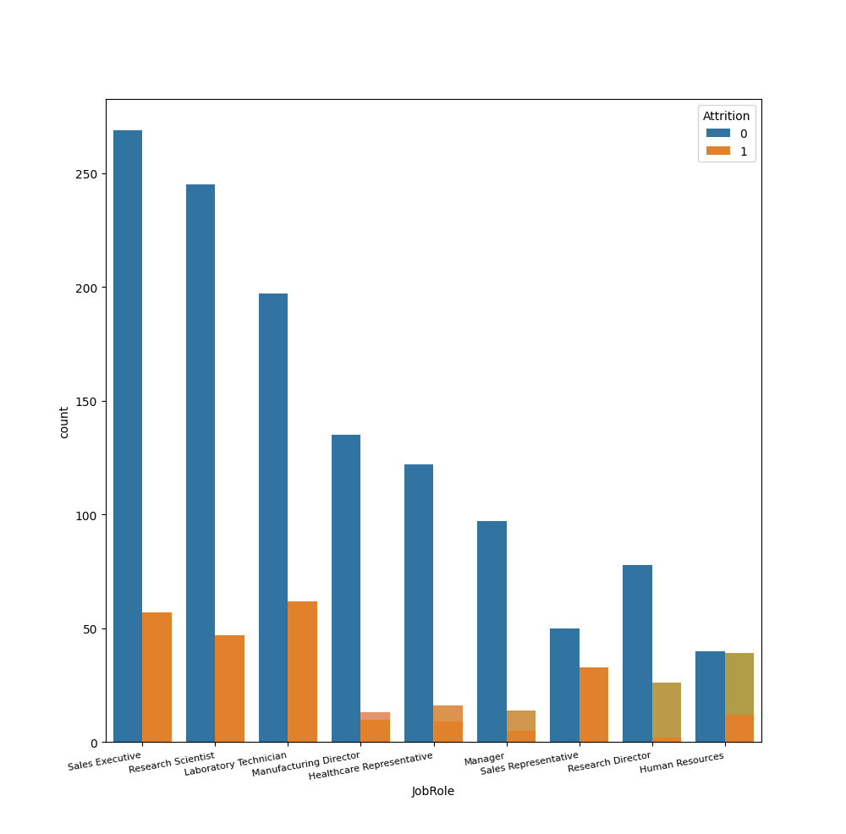
Analysis Charts
Fig 4. Employee Leave Countplot vs. Jobrole

Slide 17
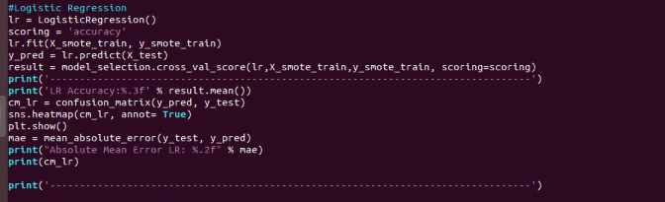
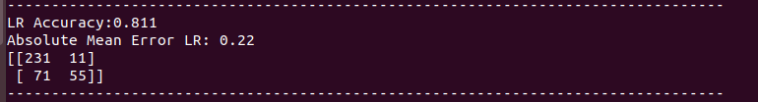
Logistic Regression

Slide 18
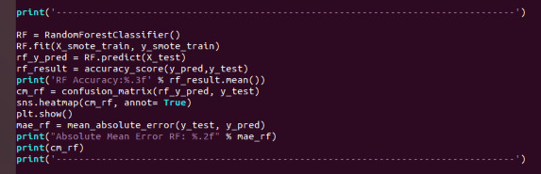
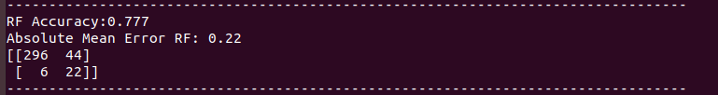
Random Forest

Slide 19
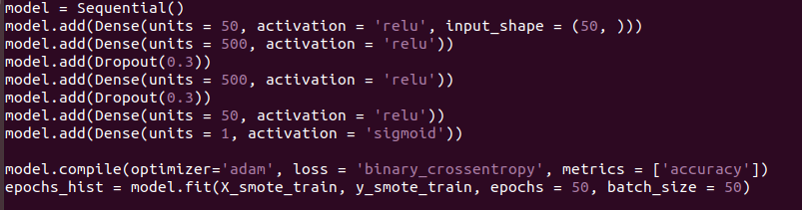

Artificial Neural Network

Slide 20
Result
Algorithms | Accuracy
Logistic Regression | 0.811
Random Forest | 0.777
Artificial Neural Network | 0.837

Slide 21
Applications
Less budget for hiring; Low manpower costs
Save time; New ideas
Will need less efforts and efficient; Higher performance
Setting the organization culture
Measure employee satisfaction
Compensation; 360 feedback

Slide 22
References
Harvard Business Review, Professors Brooks Holtom of Georgetown University and David Allen of Texas Christian University
TowardsDataScience.com
Kaggle.com
https://www.cnbc.com/2019/09/10/this-algorithm-can-predict-when-workers-are-about-to-quitheres-how.html

Slide 23
Thank You!

